Slide 1
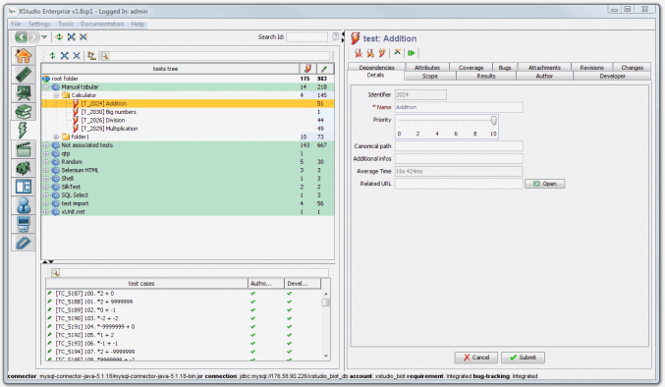

XSudio
Test management tool
Team: Star of Sierra Leone
Milena Bozhanova, Georgi Georgiev, Georgi Stoykov, Stefan Hristov, Miroslava Andonova
Telerik QA Academy

Slide 2

About
XQual Studio (XStudio) is Application lifecycle management solution. It is 100% graphical and modular in design test management application that handles the complete life-cycle of QA/testing projects from end to end: users, requirements, specifications, documents, projects (scrum oriented), tests, test plans and test reports, bugs.

Slide 3
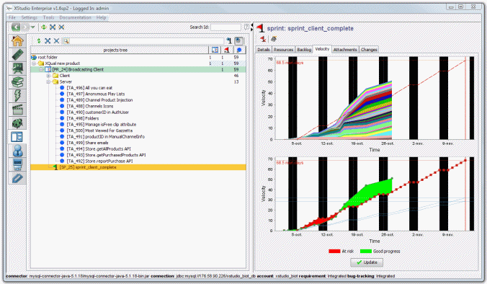
Main features(1)
100% graphical (and tree-based for flexibility)
Web access (through Java WebStart)
Personal Dashboard
Integrated management of ALL actors involved in the QA/testing project: users, systems under test, requirements, specifications, projects tests, basic test procedures, structured test procedures, test campaigns, test reports, defects
Document sharing (including versioning and locking capabilities)
User profile customization (rights management)
User groups/teams (access to specific projecs)
Customization of all generated documents (testplans, test reports etc.)

Slide 4
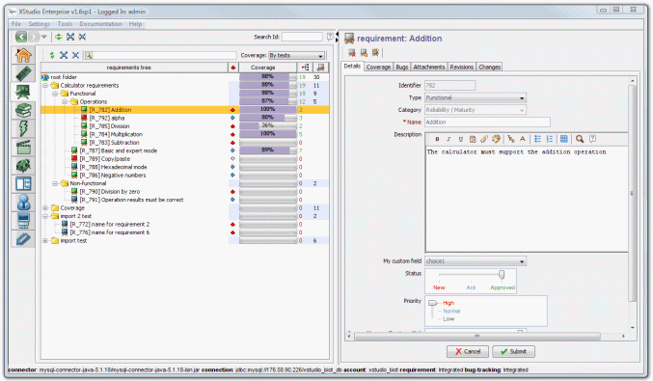
Main features(2)
Custom fields (add-on)
ALL data stored in MySQL, Oracle or SQLServer
Support for automated and manual tests execution
30+ different launchers to execute automated tests
Connectors to the most famous bug-tracking systems (Generic, JIRA, Trac, Bugzilla, Mantis)
Workflow on requirements, specifications, test authoring, test implementation status and defects
Versioning and locking mechanism on attachments
Attachments on requirements, specifications, tests, test cases, defects, folders/container

Slide 5
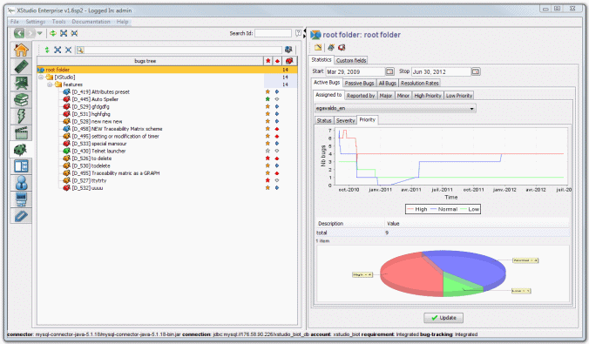




Main features(3)
Email notifications (test reports, status changes, defects changes etc.)
Scheduling test campaigns execution
Powerful search engine
Embedded spell-checker
Test case parametrization (including pairwise algorithm)
UTF-8 compliant (support of any accentuated languages such as french, chinese, arabic, hebrew etc.)
Languages - English, French, Spanish, German, Italian, Chinese
iPhone/iPad apps

Slide 6


Open-Source launchers
Notes:
http://www.xqual.com/open_source/launchers.html

Slide 7
XStudio
?
?
?
?
?
Questions?
?
?
?
?
?
?

